Slide 1
Design and Analysis of Algorithms Introduction to graphs, representations of a graph
Presented By
Muhammad Atif Tahir
From
Haidong Xue

Slide 2
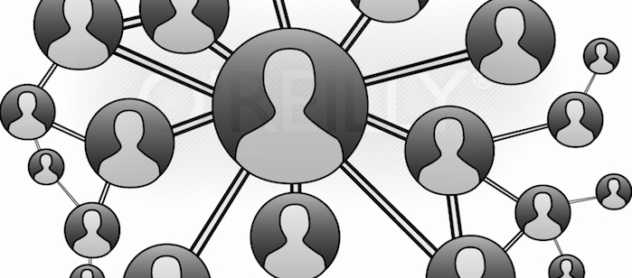
Why graphs are important
Graphs are used a lot in computer science
Social network (face book, linked in)

Slide 3

Why graphs are important
Graphs are used a lot in computer science
Computer networks

Slide 4
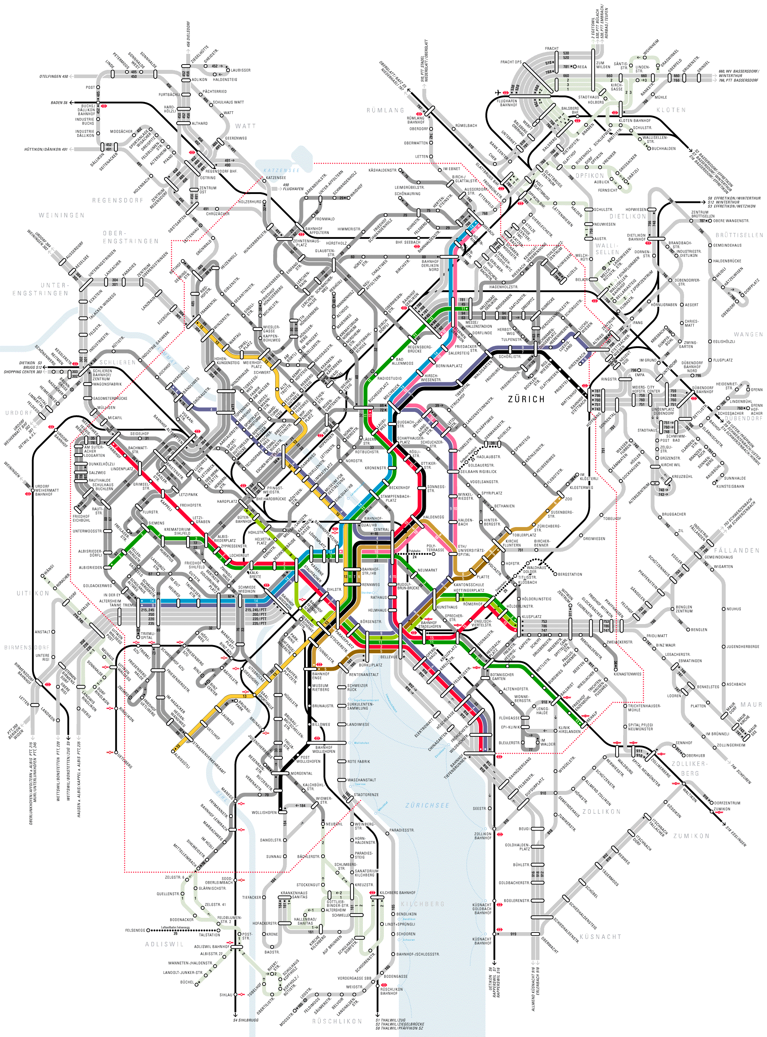
Why graphs are important
Graphs are used a lot in computer science
Transportation network

Slide 5
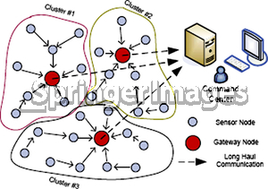
Why graphs are important
Graphs are used a lot in computer science
Wireless sensors

Slide 6
What are graphs?
A set of vertices V and a set of edges E
Each edge is a ordered pair of two vertices
G = (V, E)
E.g.
V = {1, 2, 3, 4, 5, 6}
E = {<1, 2>, <1, 4>, <2, 5>, <3, 6>, <3, 5>, <4, 2>, <5, 4>, <6, 6>}

Slide 7
What are graphs?
V = {1, 2, 3, 4, 5, 6}
E = {<1, 2>, <1, 4>, <2, 5>, <3, 6>, <3, 5>, <4, 2>, <5, 4>, <6, 6>}
1
2
3
4
5
6

Slide 8
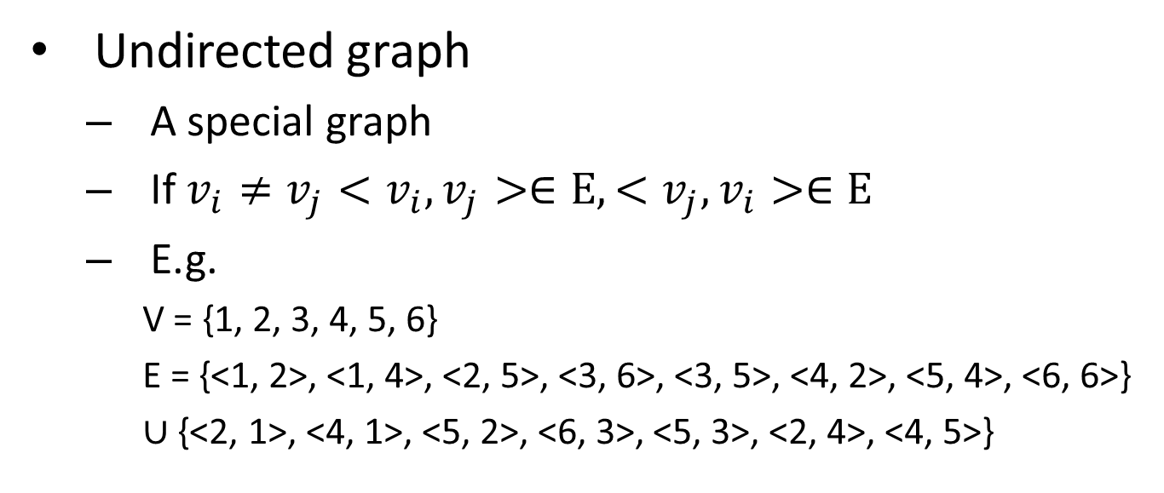
What are graphs?
Undirected graph
A special graph
If $v_{i}≠v_{j}<v_{i},v_{j}>∈E,<v_{j},v_{i}>∈E$
E.g.
V = {1, 2, 3, 4, 5, 6}
E = {<1, 2>, <1, 4>, <2, 5>, <3, 6>, <3, 5>, <4, 2>, <5, 4>, <6, 6>}
$∪$ {<2, 1>, <4, 1>, <5, 2>, <6, 3>, <5, 3>, <2, 4>, <4, 5>}
1
2
3
Use a undirected line to indicate a pair of edges or a self edge
4
5
6

Slide 9
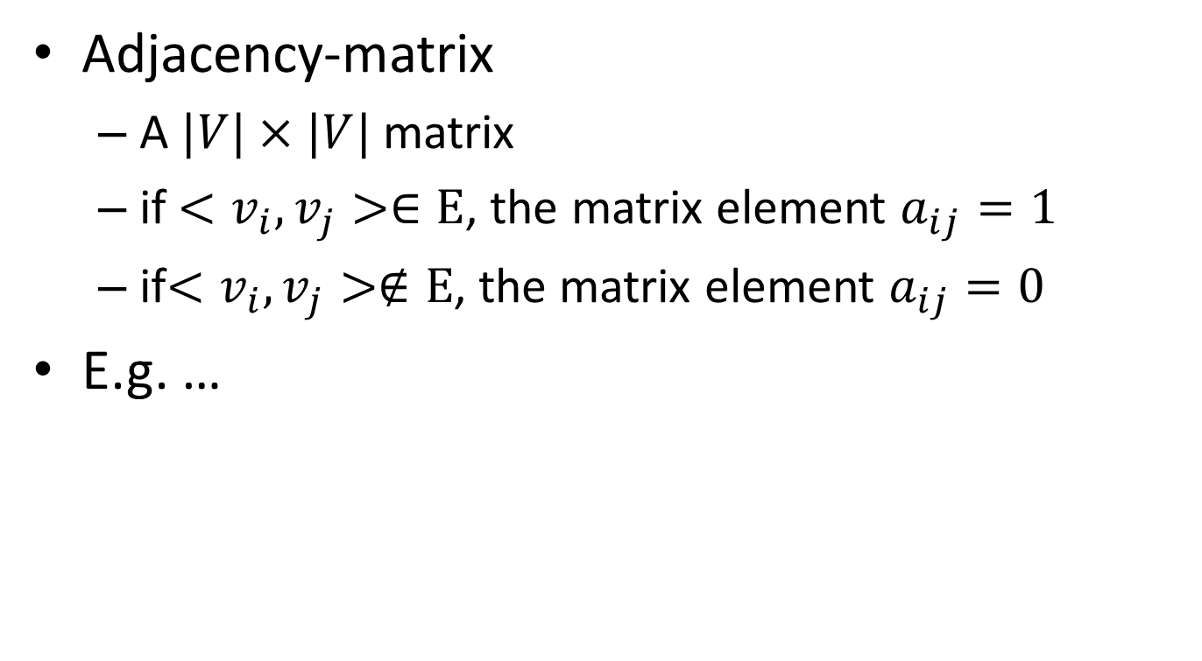
How to represent a graph?
Adjacency-matrix
A $|V|×|V|$ matrix
if $<v_{i},v_{j}>∈E$, the matrix element $a_{ij}=1$
if$<v_{i},v_{j}>∉E$, the matrix element $a_{ij}=0$
E.g. …

Slide 10

How to represent a graph?
1
2
3
E.g.
4
5
6
 | 1 | 2 | 3 | 4 | 5 | 6
1
2
3
4
5
6
0
1
0
1
0
0
0
0
0
0
1
0
0
0
0
0
1
1
0
1
0
0
0
0
0
0
0
1
0
0
0
0
0
0
0
1
What is the space complexity?
S(n) = $Θ({|V|}^{2})$

Slide 11
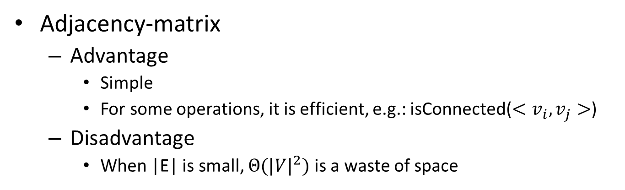
How to represent a graph?
Adjacency-matrix
Advantage
Simple
For some operations, it is efficient, e.g.: isConnected($<v_{i},v_{j}>$)
Disadvantage
When |E| is small, $Θ({|V|}^{2})$ is a waste of space
 | 1 | 2 | 3 | 4 | 5 | 6
1
2
3
4
5
6
Can we improve the space complexity?
0
1
0
1
0
0
0
0
0
0
1
0
0
0
0
0
1
1
0
1
0
0
0
0
0
0
0
1
0
0
0
0
0
0
0
1

Slide 12
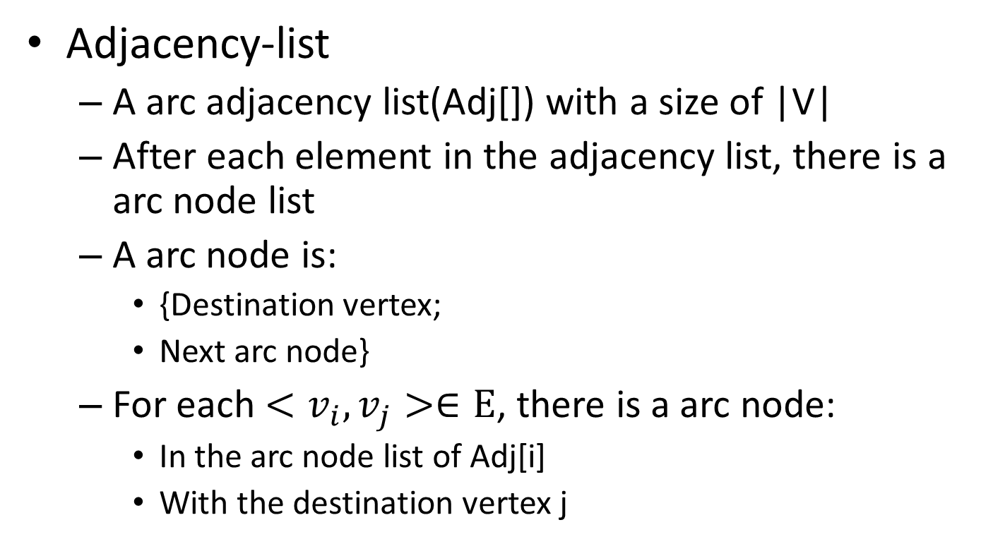
How to represent a graph?
Adjacency-list
A arc adjacency list(Adj[]) with a size of |V|
After each element in the adjacency list, there is a arc node list
A arc node is:
{Destination vertex;
Next arc node}
For each $<v_{i},v_{j}>∈E$, there is a arc node:
In the arc node list of Adj[i]
With the destination vertex j

Slide 13
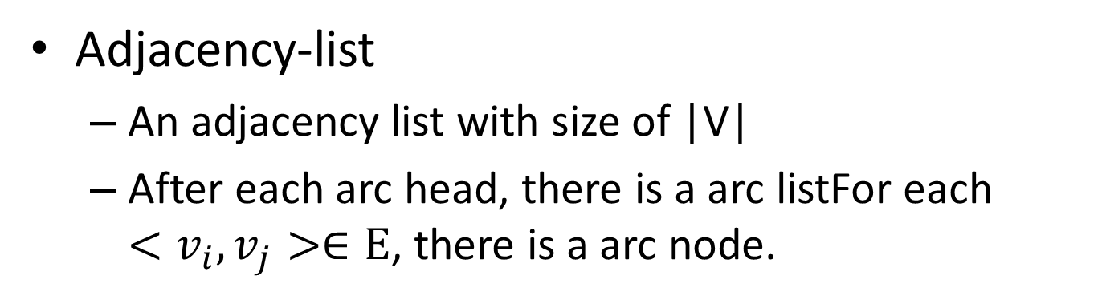
How to represent a graph?
Adjacency-list
An adjacency list with size of |V|
After each arc head, there is a arc listFor each $<v_{i},v_{j}>∈E$, there is a arc node.
2
next
1
2
3
1
2
next
4
next
NIL
2
5
next
NIL
4
next
5
next
6
next
3
5
next
6
next
NIL
2
next
5
next
4
2
next
NIL
4
5
6
5
4
next
NIL
4
next
6
6
next
NIL
6
next
Adjacency-list

Slide 14
How to represent a graph?
How to represent an attribute for an edge or a node?
Put satellite in vertices or edges and store them
Edge
Edge
1
2
next
4
next
NIL
 | 1 | 2 | 3 | 4 | 5 | 6
1 | NIL | Edge | NIL | Edge | NIL | NIL
2 | NIL | NIL | NIL | NIL | Edge | NIL
3 | NIL | NIL | NIL | NIL | Edge | Sat.
4 | NIL | Edge | NIL | NIL | NIL | NIL
5 | NIL | NIL | NIL | Sat. | NIL | NIL
6 | NIL | NIL | NIL | NIL | NIL | Edge
1
Vertex
2
Vertex
3
Vertex
4
Vertex
5
Vertex
6
Vertex

Slide 15
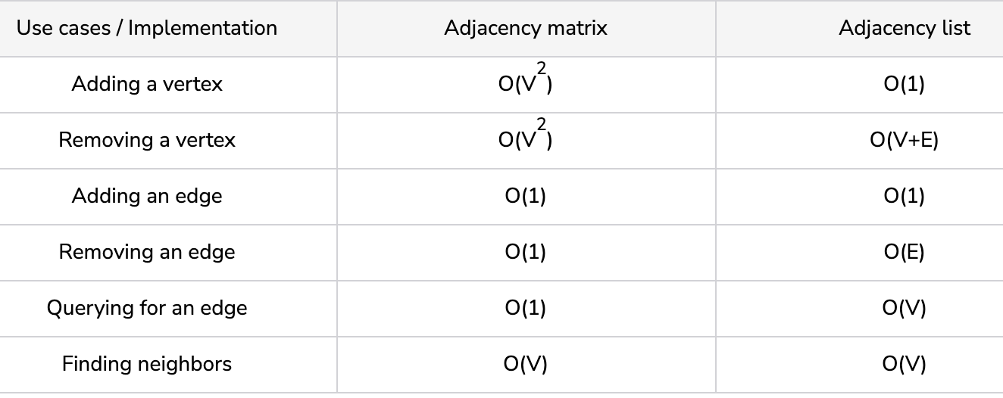
Time complexity comparison

Slide 16
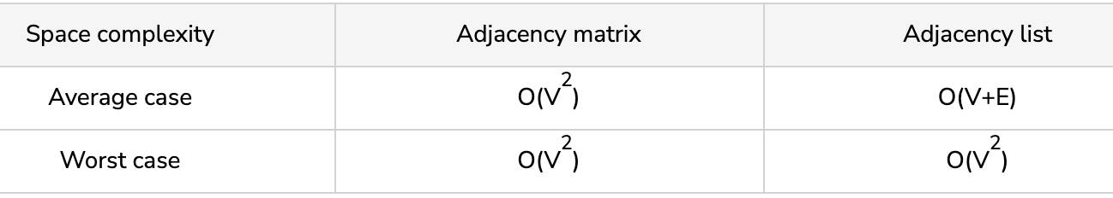
Space complexity comparison

